Slide 1


Slide 2
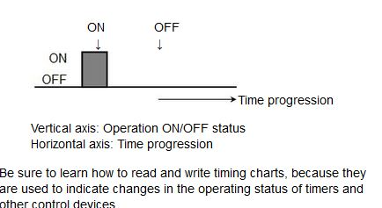
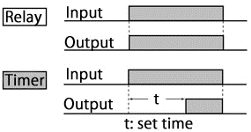
Operation Mechanism
Let us look at the timer operations compared with the relay operations.
The relay switches the contacts and sends the output signal at the time when the voltage is applied to the coil.
On the other hand, when the timer receives an input signal, its timing unit starts to measure time. When the preset time is reached, the timer switches the contacts and sends an output signal.
As you can see, timers are different from relays in that timers add the element of time to output signals.
A timing chart can be used to show the operations of the timer and the relay as follows.

Slide 3
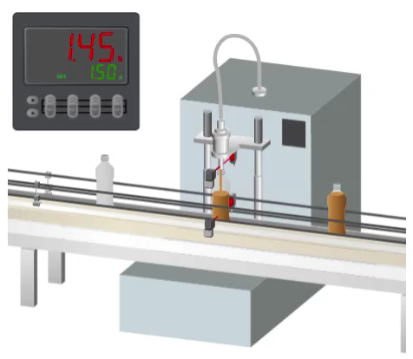
First, let us look at how the timer is used in factory automation.
This is the process where juice is filled into empty bottles coming down a conveyor. The fill quantity is adjusted by controlling the valve open/close time using a timer.
It is also used in a variety of other process machines and production lines, such as for setting the press time of a press machine or a stirring time of a mixer.

Slide 4
Operating Mode
The operating mode refers to how the output signal turns ON and OFF when the preset time is reached.
There are four basic operating modes which are used frequently. Among these modes, ON-delay operations are most frequently used. View the time chart and the corresponding application example below.
Some timer models are equipped with 10 or more types of operation modes. Where such multiple operation modes are present, they can be switched using DIP switches or selection switches.
Operating Mode
ON-DELAY
OFF-DELAY
Flicker Mode
Interval Mode

Slide 5
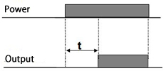
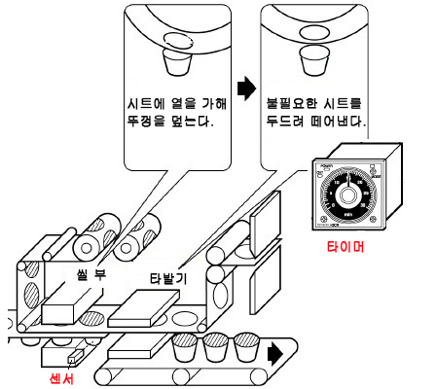
When the timer is supplied with power, it provides the output signal after the preset time.
1. ON-delay Operations
*t: Set time
An Application Example for ON-delay Operations
Apply a lid and heat-seal the container
Punch off the excess part of the lid
The left figure shows a production line for packing pudding. In this process, a sheet is pasted to cover the top of a pudding-filled cup, and the extra sheet material is punched out. When the cup with the sheet pasted is detected by a sensor, the puncher will run three seconds thereafter.
Timer
Seal
When pressing the button of the traffic sign, the color of light turns from red to green after designed time.
Sensor

Slide 6
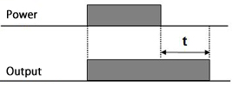

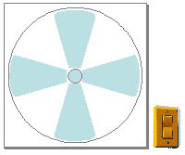
3. OFF-delay Operations
When the timer is supplied with power, the output becomes ON at the same time, and remains ON only for the preset time.
Application Examples for OFF-delay Operations
The car’s indoor light is automatically on for a certain time for drivers who is about to get in the car.
The fan stops running one minute after the switch is turned OFF.

Slide 7
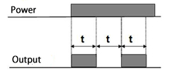
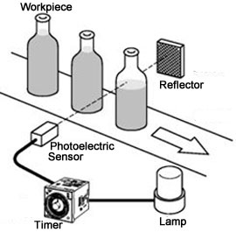

4. Flicker Operations
When the timer is supplied with power,
the output repeats ON/OFF for each preset time.
Application Examples for Flicker Operations
The fountain jets and stops in alternate 2 minutes.
When a product abnormality is detected, a lamp blinks to notify the operator. When defective goods are detected by the photoelectric sensors, the timer output repeats ON/OFF at a certain interval and blinks the lamp.
Note: The available operating modes vary according to the timer model.

Slide 8
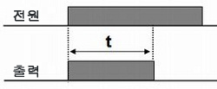
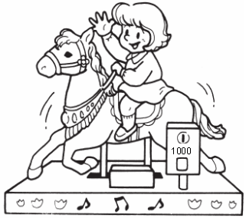
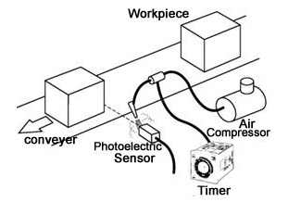
2. Interval Operations
When the timer is supplied with power, the output turns ON at the same time. The output stays on for a preset time interval.
Power
Output
Application Examples for Interval Operation
Automatic Cleaning of the Detection Surface of the Photoelectric Sensor
Operation is continuing for 5 minutes after inserting coin.
Blows air for a certain period to get rid of dust from the surface of the photoelectric sensor. As soon as the photoelectric sensor detects the workpiece, the preset time air compressor starts to run.

Slide 9
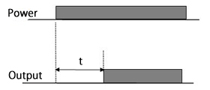
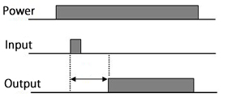
Timer Start Methods
The operating mode is divided into two types according to the start method. The operations which we learned in the previous section are for the power ON start.
Let us use the ON-delay operation as an example to look at the differences.
1. POWER ON-DELAY
2. SIGNAL ON-DELAY
Timing is triggered by power ON/OFF to the timer .
Voltage is applied to the power supply unit of the timer in advance, and timing is started upon being triggered by ON/OFF of the input signal.
External inputs are necessary for models that use the signal start method. They thus have many terminals. Accuracy will also be affected.
*The available start methods and operation modes vary according to the timer model

Slide 10
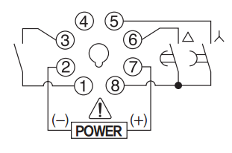
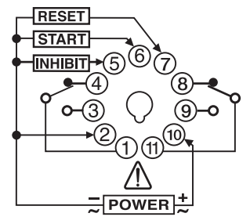
Differences between Power ON Start and Signal Start
Differences between Power ON Start and Signal Start (Accuracy)
Operation will not be stable for a short period of time after power is supplied to the timer.
Power ON start:
Operation is not stable because the timing starts at the same time that the power to the timer is turned on. Thus, variation will occur in the operating time immediately after the timer starts.
Signal start:
The time is accurate because the voltage is applied to the timer before the timing starts.
In the case of an analog timer such as model MA4N, accuracy will not be affected no matter how it is used. However, accuracy will be affected in the case of a digital timer. To perform precise time control down to hundredths of a second, such as 1.28 seconds, it is necessary to use signal start.

Slide 11
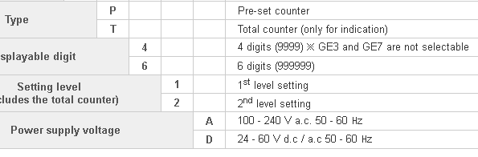
Supply Voltage
You must apply a voltage to the power supply unit to use a timer. This voltage is described using Power Supply Voltage on the datasheet.
Select the proper voltage specifications according to the power available for the application.

Slide 12
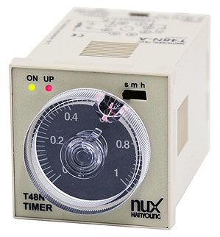
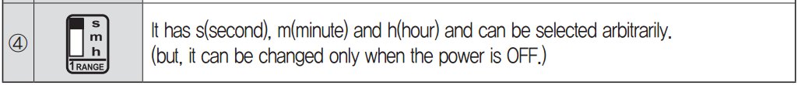
Time Specifications
The time specifications are the time that can be measured by a timer.
Select the correct model for the time range which you will measure. For example,
T48N is in multi time range specifications where many time ranges can be switched by "DIP Switch" or "Selector Switch".

Slide 13
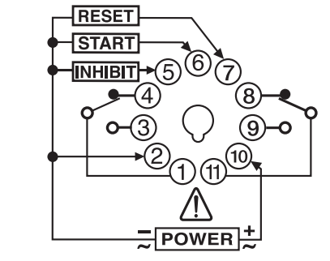
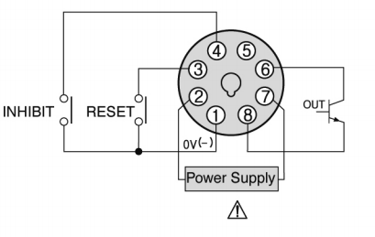
Control Output
Control outputs are signals that the timer sends when a preset time is reached.
Timers have two types of outputs: contact or transistor. The model numbers are different for timers with different output type.
Contact Output (Relay Output)
The timer output unit contains a relay.
"DPDT contact output" refers to that there are two SPDT switches therein. As contacts are present, a relatively high current can be turned ON/OFF without paying attention to the load's voltage type (AC/DC).
2. Transistor Output
The timer output unit contains a transistor. As no contacts are present, it is possible to turn ON/OFF the load at a high speed and at a high frequency. However, it can only handle DC and has a lower current capacity compared with relay output.
Ex) TF4

Slide 14
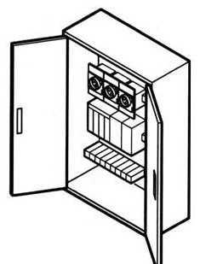
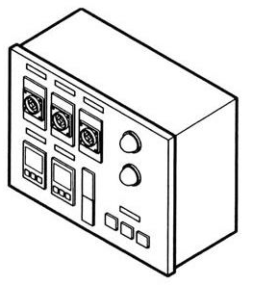
Timer Mounting
1. DIN Rail Mounting
Method by which the timer is mounted inside a control panel:
In order to mount a timer on the DIN Rail inside a control panel, it is necessary to select a DIN Rail mounting-compatible timer or socket.
2. Flush Mounting
Method by which the timer is mounted onto the surface of a control panel :
As it is used after being embedded in the panel, it is must be fixed by an adapter for flush mounting.

Slide 15
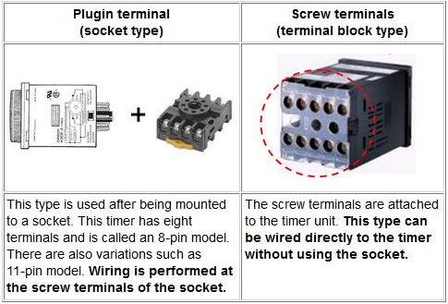
Timer terminal shapes
Timer terminal shapes are mainly of two types: plugin terminal (socket type) and screw terminal (terminal block type). Additionally, easy termination with Cage Clamp terminals is also possible for some models.
In the case of a socket type, select a socket appropriate for the mounting method.

Slide 16
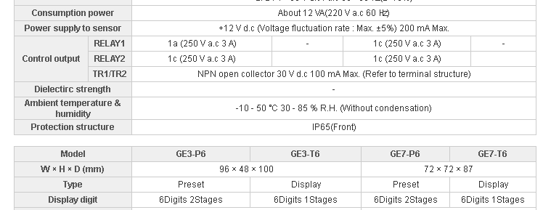
Degree of Protection
Degree of protection means the degree to which the particular model's structure is protected from ingress of dust and water. Typical levels are specified by IEC standards , described in the format of IP**, which can be found at the Specifications section in the datasheet.
In the food industry, it is required to clean the devices carefully from the viewpoint of hygiene. To mount a timer on the panel on which water may be splashed, select the timer with a higher "Degree of Waterproof Protection."

Slide 17
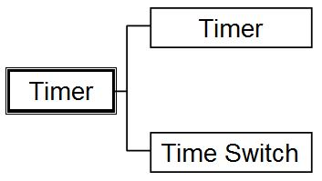
Timer Types
Timers of Hanyoung Nux are largely classified into two types: timer and time switch
The timers we discussed so far are equipment controlled using time duration.
On the other hand, time switches are equipment controlled using time on the clock. We will introduce time switches in later pages.

Slide 18
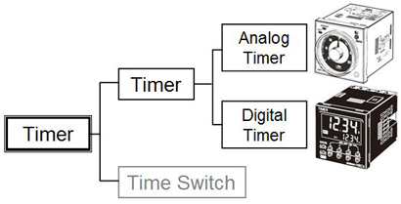
Analog Timers and Digital Timers -1
Timers controlled by time duration, which we have discussed so far, consist of two types: analog timers and digital timers. Let us look at their differences.
Settings
With an analog timer, the time is set with a time-setting dial. This makes time-setting fast and easy. You can turn the dial to make adjustments while monitoring the effect on equipment operation.
The digital timer specifies the preset time with numbers, using up/down keys. Therefore, there is no worry about setting errors no matter who makes the settings and how many times.

Slide 19
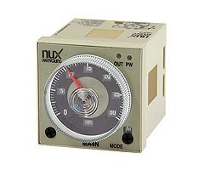
Analog Timers and Digital Timers -2
Display
Most analog timers do not display elapsed time but they have indicators that allow you to check their operating status, such as timing or outputting.
Digital timers digitally show both the elapsed time (present value) and the preset time. You can see the present value change when the timer operates. This is not possible with analog timers.
Output Indicator - Lit when output is turned on.
Power Indicator - Flashes green when the timer operates; lit when the timer stops operating.
①
①

Slide 20
Analog Timers and Digital Timers -3
Accuracy
Digital and analog timers use different types of internal circuits to generate time. Digital timers are very accurate because they use expensive precision circuits. They are the best selection when requiring accurate time control down to hundredths of a second, as for example 1.25 seconds.
Additional Functions
The digital timer model GE series contains various additional functions along with timing operations, such as key protect function and display color switch function.
Key Protection Function
When the key protection switch is "ON", in accordance with the key protection level (KP-1-KP-7), the operations of each key are disabled, making it possible to prevent wrong settings. When the key protection switch is "ON", the key protection indicator is lighted up.
Set Value Limit Function
Can set the upper limit value of a set value. Can prevent the output equipment from performing unexpected operations arising from mis-setting.
Output Count Function
Counts the number of times the output turns ON. (Warning display, count monitor available, in units of 1000 times). Contributes to life prediction for the timer and the load.
Twin Timer Function
Same as the flicker operations, the twin timer operations repeat ON/OFF of output at a certain interval. The time unit can also be set for the ON time and the OFF time respectively.

Slide 21


What Is a Time Switch?
Time switch is a control device that turns a load ON/OFF at a preset time on the clock. Time switches are categorized by the time period during which time-based control is performed.
Daily time switch:
Control the output by setting ON and OFF times
on a daily basis.
Weekly time switch:
Control the output by setting ON and OFF times
on a weekly basis. Different settings can be made for each day of the week.
Yearly time switch:
In addition to the weekly time switch operation, settings for yearly holidays (non operation) such as national holidays and long vacation are available.

Slide 22
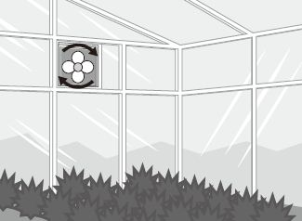
Time Switch Application Examples
Used for warm-up of packaging machines and machine tools in factory automation.
Time switches are also used in a variety of applications other than factory automation.
Chime in school and office
Water spray in golf courses
Ventilation of greenhouses
Turning street lights ON/OFF

Slide 23
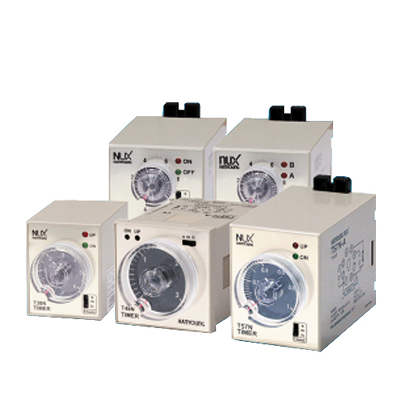
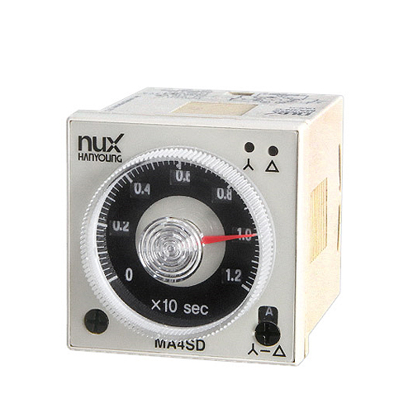
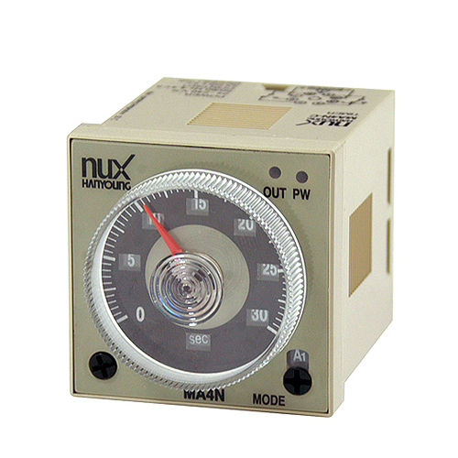
Product Portfolio - Analog Timer
Hanyoung Nux offers a rich product portfolio of timers in order to support a variety of needs, with various sizes, shapes, setting methods and additional functions. The models shown below in red are major general-purpose analog timers. The top page of each timers' respective catalogs are attached for your reference.
*Size
The front sizes of control equipment such as timers are specified in "DIN standards" (German industry standards). DIN48x48mm indicates that the size of the timer front is vertical 48mm x horizontal 48mm. There are also sizes such as DIN72x72mm and DIN96x96mm.

Slide 24
Analog Timer series
On-Delay Timer
Flicker Timer
Dual Timer
T38N
TF62N
TF62D
T48N
T57N

Slide 25
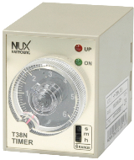
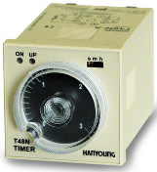
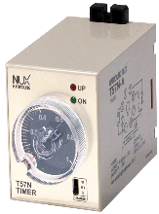
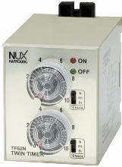
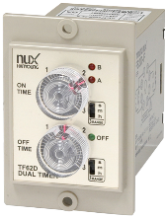
Analog Timer product guide
SIZE
40(W) X 50(H) mm
T38N
T38N
48(W) X 48(H) mm
T48N
50(W) X 62(H) mm
T57N / TF62N / TF62D
T48N
MODE
ON-Delay Timer
T38N / T48N / T57N
Twin Timer
TF62N
T57N
Dual Timer
TF62D
Control
Output
Type – A (1a + 1c)
T38N / T48N / T57N
TF62N
Type – B (1c + 1c)
Type – C ( 2c)
Type – D ( 1c)
TF62N
TF62D
Type – F ( 2c)
TF62D

Slide 26
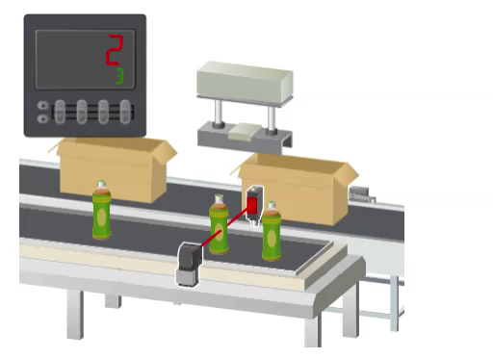
Counter Application Example 1
Let us understand how the counter is used in factory automation.
In this example, the counter counts the number of bottles coming down a conveyor, and places a set of three bottles to be transported into one box.
The counter works in the following way:
Set the number 3 in the counter in advance.
The counter will then count the number of signals received from the photoelectric sensor.
It will send a signal to the robot hand every time the received signal count reaches three.
The robot hand receives an output signal from the counter, and transports three bottles into one box.

Slide 27
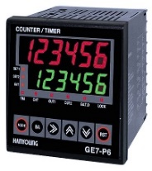

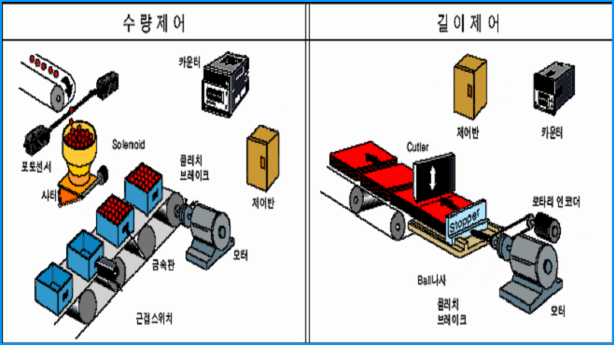
Counter Application Example 2
Quantity control
Length control
Counter
Control panel
Counter
Clutch
brake
Photo
Sensor
Control panel
Rotary Encoder
Metal plate
Motor
Clutch
brake
Proximity sensor
Motor

Slide 28
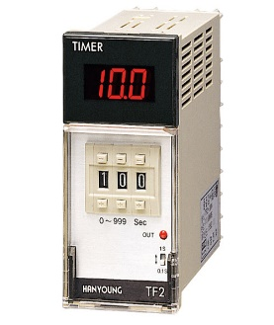

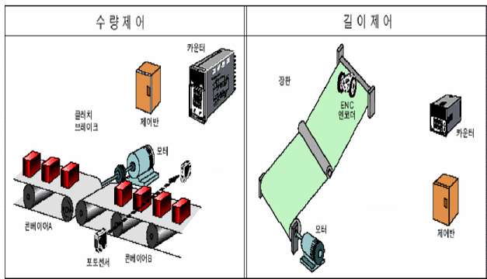
Counter Application Example 3
Quantity control
Length control
Sheet
Clutch
brake
ENC
Encoder
Control panel
Counter
Motor
Conveyor
A
Motor
Control panel
Photo
Sensor
Conveyor
B

Slide 29


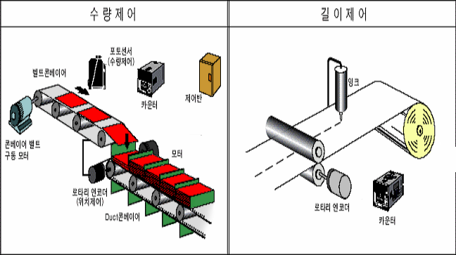
Counter Application Example 4
Quantity control
Length control
Photo
Sensor
Conveyor
Ink
Counter
Control panel
Conveyor
Motor
Motor
Rotary
encoder
Rotary
encoder
Duct
Conveyor
Counter

Slide 30
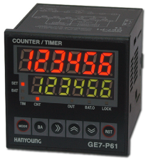
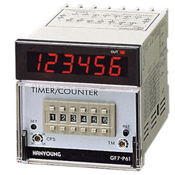
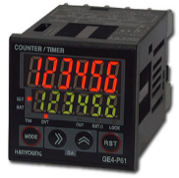
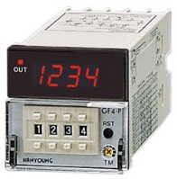
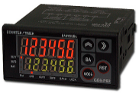
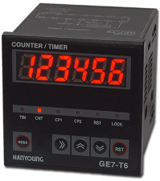
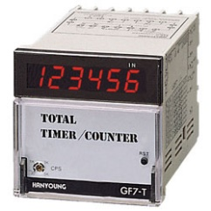



Preset Counter and Totalizer
A preset counter accepts a pre-determined set value or target before the operation begins. The preset counter sends an output signal when its count reaches the set value. The preset counter and its application were discussed in the previous page.
Another type of counter, called totalizer, only performs display and does not send any output signal. Totalizers are used when it is necessary to only show the total number of individual products counted which can be associated with a specific period of time which is determined by the user.
As you can see, Hanyoung Nux counters come in these two types, one which sends an output signal and one which does not.
Preset counter
Counter
GE6-P
GE4-P
GE7-P
GF4-P
GF7-P
Total counter
Displaying counted value
without output control function
GE6-T
GE4-T
GE7-T
GF4-T
GF7-T

Slide 31

Operation Mechanism
Let us look at the mechanism of Preset counter operations in detail.
The power supply section is connected to a power supply for running the counter.
The input section is connected to input devices such as sensors.
The count section counts the number of signals received from the input device.
The display section displays the counted number (present value).
The setting section presets a number (set value).
The compare section compares the present value and the set value, and outputs a signal to the output section if they are the same
Upon reception of an output signal, the output section switches contacts and activates the output device.
Operations 1 to 7 are available for preset counters, while operations 1 to 4 are available for total counters.
Power Section
Input Section
Count Section
Display Section
Setting Section
Compare Section
Output Section
Output

Slide 32



Regarding Input Signals
The counter counts the number of times the input device connected to the counter turns ON and OFF. This ON/OFF signal is called a pulse.
The present value display changes upon the rising edge of the input signal (as shown in this timing diagram).
When the set value of the preset counter is 3, it sends an output signal at the rising edge of the third input signal.
What is a Pulse?
A pulse is a signal with a short time width. It is called a periodic pulse train when ON/OFF is repeated periodically.
설정값 = 3
미리 설정한 값 (설정값)
*. 미리 정해 둔 숫자를 설정값 (프리셋값) 이라고 하며, 그 숫자를 다 세고 제어신호를 출력하는 것을 ‘카운트-업’ 이라고 합니다.
입력신호가 하나 들어올
때마다 하나씩 올라간다.
계수값
입력신호
카운터의 입력 상태
출력신호
카운터의 출력 상태
1
2
3
카운터 전면에 표시
되는 계수값
표시값

Slide 33


Input Method
(NPN Input and PNP Input)
Counters receive signals from the input device by two methods: NPN input (No-voltage inputs) and PNP input (Voltage input).Both PNP and NPN input methods are used depending on regional safety and electrical standards. Some regions use both methods, some prefer NPN for mechanical contacts, and some prefer PNP for sensor inputs. Check standards to see which method is most appropriate in your region.
NPN Input (No-voltage Input)
It is not necessary to connect an external power supply.
PNP Input (Voltage Input)
It is necessary to connect an external power supply to supply power to the input circuit.

Slide 34


Control Output
Control outputs are signals that the counter sends when its present value reaches its set value. Counters have two types of outputs: contact or transistor. Select counters according to the type of output device and switching frequency.
Example of contact output Example of non-contact output

Slide 35



Reset Method
Reset refers to returning "Present value" and "Output" to their initial states before count start. There are four reset methods.
1. Manual reset
Resets the counter by pressing the reset key on the front of the counter.
2. External reset
Resets the counter by providing a signal(momentary or maintained) from an external input device to the reset input signal terminal.
3. Automatic reset
Performs automatic reset when the set value is reached. (It will be covered with details later in this course).
4. Power-on reset (Selected Models)
Resets the counter by turning OFF and then ON the power to the counter.
reset
start
stop
Memory Backup Function
This function can memorize the count value even while the power is OFF. When power supply is resumed after being turned OFF partway into the process, the count value before the power was turned OFF is displayed.

Slide 36

What Is Counting Speed?
The counting speed is the maximum number of input signals that the counter can count in one second.
The unit for the counting speed is cps.
In the datasheet, it is called the maximum counting speed. For example, "Maximum counting speed of 10 cps means that a counter can count a maximum of ten pulses in one second.
2. The value of the counting speed
Usually, any counter has both a slow counting speed and a fast counting speed.
You can select the counting speed with a DIP switch or a selector switch.

Slide 37


Selecting the Counting Speed
Counting speed is selected according to the type of input device and the frequency of the signals received.
Using a contact input device
A slow counting speed is always best when you use a contact input. If a fast counting speed is selected and a contact input is being used, the contact bounce will also be counted, causing a mis-counting to occur.
Bounce
Contact bounce is a rapid and repeating opening and closing of an electrical contact due to both mechanical impact and electrical arching.
For example, a ball will bounce before stopping if it falls from a high location. This is the same as the mechanical contact "bounce" phenomenon. When switch contacts change over, the contacts are bounced (closed and opened) quickly three or four times before they finally stop.

Slide 38



Using a no-contact input device
The counting speed is set according to the number of signals which is applied.
Typical no-contact input equipment connected to the counter include photoelectric sensors, proximity sensors, and rotary encoders.
A fast counting speed is selected when the counter receives and counts signals sent from a sensor or a rotary encoder at a high speed (high frequency). However, the slow counting speed, which is resistant to noise, is selected if the number of input signals is sufficiently small to be counted by a slow counting speed.
Rotary Encoder
A device that outputs signals through rotation of an axis.

Slide 39





Input Mode
(Up, Down, Up/Down)
The counter has three input modes. This input mode of
GF series can be switched by using its DIP switches.
1. Up count
The count value increments for each count. The display starts from zero.
2. Down
The count value decrements for each count. The display starts from Set Value.
3. Up/Down
Increments with one input and decrements with the other input.
Current Production Quantity: 1400
Target Production Quantity: 2000
Remaining Production Quantity : 600
Target Production Quantity : 2000

Slide 40
Other Selection Points
In addition to the information covered so far, there are also other considerations for selecting the appropriate counter model.
Voltage Specifications (Supply Voltage): The voltage applied to the power section of the counter is described in the catalog as supply voltage. Select the voltage specifications in accordance with the voltage to be used.
Number of Digits: Refers to the maximum number of digits that can be used to count and display a number. While the number of digits varies depending on the model, generally speaking, preset counters frequently use four digits and six digits.
External Dimensions: Size of DIN standards, similar to Timers.
Terminal Shape: Mainly of two types: plug-in terminal (socket type) and screw terminal (terminal block type) . In the case of socket type, select a socket appropriate to the mounting method.

Slide 41

Display Unit and Set Unit
① Coefficient display (RED FND)
Display coefficient value (counter), time process value (timer), batch coefficient value and setup list.
② Setup display (GREEN FND)
Display setup value (counter), setup time (timer), batch setup value, instant
output setup (batch setup is 0 in Timer) and setup contents
③ SET1, SET2 (SET), BAT
Indicates the status of coefficient section and setup section
(BAT lamp corresponds to batch status.)
④ TIM (Timer)
This flashes when the timer progresses and remains lighted when the device
stops from inhibit input or reset.
(It is indicated in Change Mode of the device during TIM/TTWIN setup.)
⑤ CNT (Counter)
This is indicated during 1CNT/2CNT setup in Change Mode of the device.
⑥ OUT1, OUT2(OUT), BAT.O (Output Action Indication)
• BAT.O lights up when the batch setup value is set. (OUT1 Output)
• BAT.O lights up and outputs when the device operates with the instant output
• where the batch setup value is 0 (timer).
• CP1, CP2, RST : Verification of Input Status. (Exclusively for TOTAL)
⑦ LOCK:Key Lock (KEY LOCK) Action IndicationThis lights up during Lock Setup.
⑧ : This key is for function setup Mode Entry and Mode change. It can also be
used for ending after saving when changing the setup value
⑨ : Setup value change Entry and Location shift
⑩ : UP Key
⑪ : RESET KEY When SET, BAT lamp(③) on, RESET key will not operate.
⑫ : Batch and operation mode 1 stage and 2 stage conversion key. When BAT
lamp light, it is batch mode and keep operate.
⑬ : Push both of keys together, It operate same as key.
⑭ : DOWN Key
H7CX 판넬 표면은 다음과 같은 특징이 있습니다.
큰 문자로 보기 쉬운 표시
표시색 전환 기능으로 출력 상태를 멀리서도 확인 가능
각 자리수 업/다운 키로 조작이 간단 (4자리 타입)
방수/방진 구조: IP66/UL508 Type4X (방수 패킹 사용)
키 프로텍트 기능
표시색 전환 기능
카운트 값의 표시색을 출력 상태에 맞춰 3색 (적/녹/주황)으로 전환할 수 있는 기능입니다.
떨어진 장소에서도 출력 상태를 확인할 수 있으므로 편리합니다. H7CX 단자대 타입에 구비된 기능입니다.
키 프로텍트 기능
각 키 조작을 금지하고 잘 못 설정하는 것을 방지하기 위한 기능입니다.
키 프로텍트 스위치가 ON일 때, 키 프로텍트 레벨 (KP-1~KP-7)에 따라 각 키의 조작을 금지합니다. 키 프로텍트 스위치가 ON일 때는 키 프로텍트 표시가 점등합니다.

Slide 42


Model Configuration 1
GE series is most acceptable digital counter and timer with various size, functions.
You can select various options such as indicating digits, counting speed, output type, power supply etc.
예를 들어 다음 조건에서 사용하고 싶은 경우
"H7CX-A11S-N" 를 선정합니다.
1단 프리셋 카운터
설정값 50,000이하
11핀 소켓 타입
트랜지스터 출력 타입
전원 전압은 AC100V

Slide 43

Model Configuration 2
GE series is most acceptable digital counter and timer with various size, functions.
You can select various options such as indicating digits, counting speed, output type, power supply etc.

Slide 44

Connection of Input / Output Equipment
Let us look at the case where GF4-P41N is used to connect the pushbutton to the input equipment and to connect the lamp to the output equipment. First, let us look at the terminal arrangement diagram.
Terminals 6 to 10 are the input section. A pushbutton switch is connected between terminal 6 and terminal 9. Pressing the push button increments the present value by 1 (in the case of Up mode).
Input Function
When used as the 1-stage preset counter, it functions as follows:
CP1 input, CP2 input:
Reads the signal that is to be counted. Usually when CP1 is taken as count input, CP2 functions as prohibit (gate) input. That is, while CP2 is receiving input signals, the CP1 input signal cannot be received and counted.
Reset input:
This key is used to reset the count value and output.
Total reset:
Does not operate(not used). Resets the total count value when it is used as the Total and preset counter.
Terminals 1 to 3 are the output section, which is a relay contact output. Wiring using terminals 2 and 3 activates Normally Open(NO) contact. A lamp is connected here. As soon as the counter reaches the set value, the lamp lights up. Terminals 4 and 5 are the power section. These are connected to a power source for the counter.
Example diagram
for model GF4-P41N

Slide 45


Output Mode - N Mode
The output mode refers to how the output signal turns ON and OFF when the counter reaches the set value. There are three basic output modes that are used frequently. In the case of GF, the output modes used frequently are set by using the DIP switches .
N Mode: count stop and output hold
Application Example
We want to count the number of pudding cups that get filled, and then turn ON the lamp and stop the conveyor when the count reaches the target production quantity.
When the counter counts to the set value, it sends an output signal and stops the display. The counter cannot count an input signal while it is sending an output signal. When the counter is reset, the display and output will return to their initial states and then the counter again starts the counting operation. This mode is frequently used.

Slide 46


F Mode: over-count and output hold
Timing Chart (UP Mode)
The blade on the cutter that cuts the seal loses some sharpness each time it operates. After 10,000 cuts, the operator needs to replace the blade. It is necessary for the lamp to turn ON after the blade has operated for 9,000 cuts, to notify the operator of the blade replacement timing.

Slide 47


Output Mode - C Mode
C Mode: automatic reset and one-shot output
Timing Chart (UP Mode)
Application Example
When the counter reaches its set value, an output signal is sent momentarily, and then the counter performs automatic reset by itself to start the counting operation again. Unlike N mode, no manual reset or external reset is necessary. The workload is decreased, and the process is faster.
We want to automate the process of putting the filled pudding cups into boxes. Three pudding cups are put in each box. With auto reset, we do not have to wait for a sensor signal to reset the count. This saves time and hardware expense.

Slide 48



1-stage Setting and 2-stage Setting
The number of set values for activating the control output is called the number of stages. A counter that can have two set values is called 2-stage setting type or 2-stage preset counter.
Terminal Arrangement Diagram
Timing Chart
(In case of F mode)
A process where the wire is cut to the required size. The blade on the cutter that cuts the wire loses some sharpness each time it operates. After 50,000 cuts, the operator needs to replace the blade. It is necessary for the lamp to turn ON to notify the operator of the the blade replacement timing after the cutter performs 40,000 cuts, and for the buzzer to sound after the number of cuts reaches 50,000.
2-stage Setting Type Application Example

Slide 49

Other Counter Functions
Total and preset counter
In addition to the 1-stage preset counter, it has a totalizer that totalizes the count value. For example, the totalizer can count the total daily production quantity while each set of 12 bottles is packed into one box.
Batch counter
In addition to serving as a 1-stage preset counter, the batch counter counts the number of times the counter's set value is reached. As soon as the preset batch count set value is reached, a batch signal is output. In this mode, the GE uses two screens to convey information to the operator.
In this example, you want to fill a bottle of pills from a dispenser with a set amount of product.
The GE monitors the sensor that is interrupted as each pill enters the bottle.
At the preset batch count of 50, the line indexes on command from the GE.
A new bottle moves under the dispenser and the cycle repeats.
On a separate screen accessible by pressing the MODE key, the GE will display the number of bottles already filled (upper display) and a preset batch count value. When the two are equal, a batch signal will be output from the GE.

Slide 50
Other Counter Functions
Dual counter
Using the dual counter allows the count from 2 inputs to be added or subtracted and the result displayed. It is possible to specify a set value for which output turns ON when the set value matches the added or subtracted result.
Twin counter
Twin counter has two independent built-in counters. Pressing the mode key toggles between Counter 1 and Counter 2 display.

Slide 51

Counter Application(Control quantity)
Count the number of component provided
Count the number of sheets printed
Count the number of units finished process
Counter
Photo
sensor
Counter
Proxi.
sensor
Photo
sensor
Photo
sensor
Photo
sensor
Printer
Motor
Photo sensor
Lot separator
Photo
sensor
Photo
sensor
Counter

Slide 52

Counter Applications (Length control)
Cutting a sheet according to the preset length
Rolling the rope according to the preset size
Cutting the metal sheet
Cutter
Cutter
Film
Encoder
Detecting
part
Controlling Cutter
Counter
Rotary
Encoder
Encoder
Counter

Slide 53



Product Guide - Digital Counter
Hanyoung Nux offers a rich product portfolio of preset counters in order to support a variety of needs with various sizes, setting methods, and additional functions. The GE series is a typical Hanyoung Nux preset counter.
The GE series is equipped with rich functions and can be used in a wide variety of applications.
GE series
- Counter/Timer
- Batch function
- NPN/PNP input selectable
- Pre-scale setting
- Display decimal points up to 4 digits
- Off set setting
GF series
- Counter/Timer
- Set up digit of decimal points
- Selection of voltage/non-voltage inputs
- Timer range 16 kinds (10/60hexadecimal digits each 8 kinds)
LC1(Totalizer)
- Compact size LCD indicating total counter
- Battery built in so external power is not needed
- Reusing possible by replacing to the new battery
- Long battery life due to the less power consumption
- Non-voltage input of voltage input
- IP66 protective structure(front side)

