Slide 1
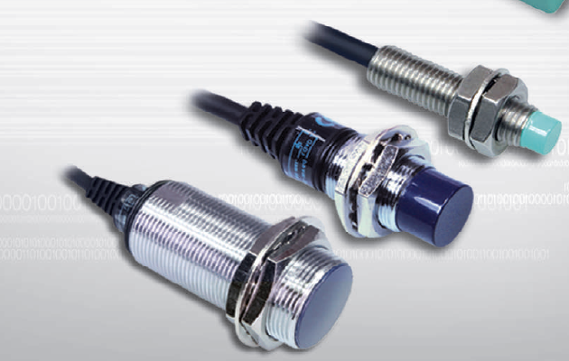
Why Proximity Sensors?
A Proximity sensor (also called "Proximity switch" or simply "PROX") responds to the presence of an object close to the sensor. In most cases this is just a few mm. Often the proximity sensor detects
an end-position of a machine part and the sensor output signal triggers another function of the machine. The main advantages of industrial proximity sensors are:
Reliable operation even in harsh environments (e.g. outdoor or oil environment)
Simple and easy operation/installation
Attractive price (e.g. less than Photoelectric sensors)

Slide 2
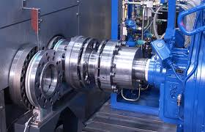
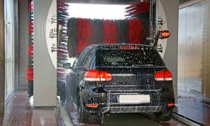
Today proximity sensors are found in many types of industries and applications. Some examples:
Automotive industry Machine tool industry Food processing industry
Utility vehicles (e.g. trucks, agricultural machines) Car washing machines

Slide 3
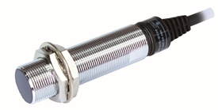
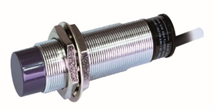
Types of Proximity Sensors
There are 2 main types of industrial proximity sensors:
Inductive proximity sensors detect objects by generating an electro-magnetic field. Naturally only metal objects can be detected.
Capacitive proximity sensors detect objects by generating an electrostatic capacitive field. Therefore all kinds of objects can be detected.
Although inductive sensors only detect metal objects, they are much more common in industry. They are less effected by external disturbances like EMC and - last not least - they are cheaper then capacitive sensors.
Inductive type
Capacitive type

Slide 4
Proximity sensors applications
- Detect the presence of aluminium cans
- Count the number of fuses
- Detect the movement of high speed table
- Check mold adhesion
- Detect engine blocks
- Decide the position at the welding spot
Inductive type (UP SERIES)
Capacitive type (CUP SERIES)
- Detect glass board on conveyors
- Detect the presence of drinks (in beverage factories)
- Detect milk in cartons
- Detect amount of corn
- Detect amount of soil

Slide 5
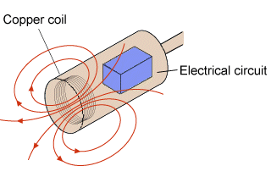
Inductive Sensor Operation
An inductive proximity sensor consists of a coil wound around a ferrite core at the sensing head. A high frequency is applied to this, generating an oscillating electro-magnetic field around it. This is monitored by an internal circuit. When a metallic object moves towards this field, electric currents (eddy currents) are created in the object.
These currents cause a transformer like effect, as a result the energy in the detecting coil lessens and the oscillations are reduced; the magnetic field strength is decreased. The monitoring circuitry detects the dropping level of the oscillations and then switches the output. The object has now been detected. Because the operating principle uses an electromagnetic field, inductive sensors excel over photoelectric sensors in environmental resistance. For example, oil or dirt generally have no influence on the operation of the sensor.
Inductive sensor operation

Slide 6
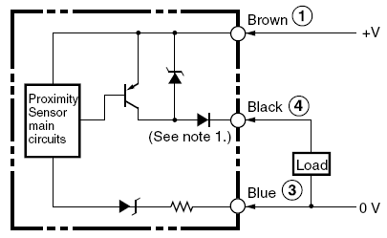
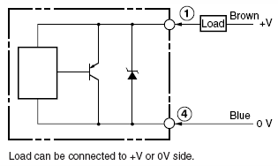
Inductive Sensor Output
Today most inductive sensor feature transistor output with NPN or PNP logic (see picture below) . These types are also called DC-3 wire models.
Inductive sensor output (DC-3 wire)
In some installations proximity sensors with 2 connections (plus and minus) are used. They are called DC-2 wire models (see diagram below).
Inductive sensor output (DC-2 wire)

Slide 7
Normally Open/Normally Closed
Proximity sensors are categorized into the operation modes normally open (NO) and normally closed (NC) describing whether the sensor output signal is high with an object or without an object sensed.
Normally open: High signal, when detecting an object; low signal without an object
Normally closed: High signal without an object; low signal, when detecting an object.
Proximity sensors with both NO and NC outputs are called antivalent models.

Slide 8
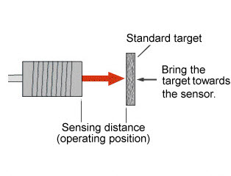
Sensing Distance - Standard Rating
The sensing distance is an important specification when designing a PROX into a machine. There are single-, double- and even triple distance inductive proximity sensors. The sensing distance quoted in the specifications for the inductive proximity sensors are based on a standard target moved axial to the sensor. This standard object is a square plate of mild steel 1 mm thick, a primarily ferrous object (defined according to EN 60947-5-2). Note: For objects moving radial to the sensing face, the sensing distance is different!
Sensing distance

Slide 9
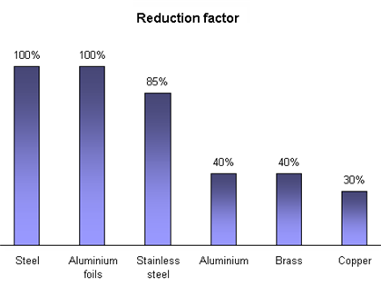
Sensing Distance Reduction Factor
Depending on metal type used the sensing range can be smaller than the rated sensing distance. The following table gives approximate reduction in sensing distance of a standard PROX for different metal materials. Detailed information about dependency on metal types can be found in the technical information in the datasheet of each inductive sensor.
Note: Special inductive sensors feature the same distance independent of metal type used. They are also called "Factor 1" proximity sensors.

Slide 10
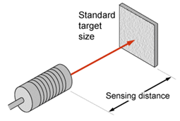
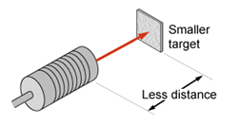
Influence of Object Size
The sensing distance is also influenced by the size of the object (smaller object will cause decrease of sensing distance. Also the kind and thickness of the plating have an influence on the real sensing distance.
Sensing distance comparison (standard size / small size targets)

Slide 11
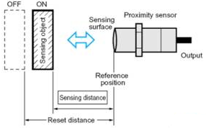
Sensing Distance - Hysteresis
The Hysteresis of a sensor describes the difference between the distance at which the sensor activates and the distance at which the sensor resets. A small Hysteresis enables a precise positioning of the object. Hysteresis value usually ranges between 5-10%.
Hysteresis

Slide 12
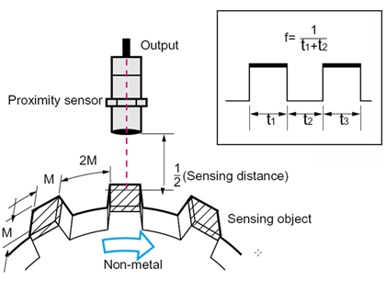
Response Frequency
According to EN60947-5-2 response frequency defines the number of detection repetitions that can be output per second when the standard test object is repeatedly brought in front of the sensor See the accompanying diagram for the measuring methods: The distance has to be 50% of the rated sensing distance; the pulse-pause ratio is defined with 1:2 (see pic.: M vs. 2M).
Response Frequency

Slide 13
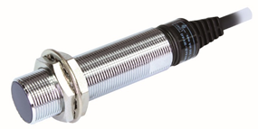
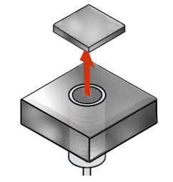
Shield Inductive Sensors
Shield PROX are made with a shielding plate around the ferrite core. This has the effect of leading the electromagnetic field to the front of the head.
A shield proximity sensor can be mounted flush in the metal surfaces, if space is limited. This also provides the advantage of mechanical protection of the sensor. As a consequence this limits the sensing range, but the sensor can be easily mounted with surrounding metals having no effect.
Shield inductive sensor
Shield inductive sensor flush mount

Slide 14
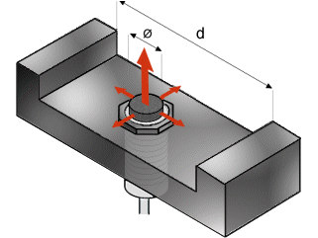
Non-shield Inductive Sensors
Non-shield sensors have no shielding around the ferrite core. The difference between shield and non-shield sensors can easily be seen visibly.
This design provides a greater sensing range than shield proximity sensors. For the same diameter size non-shield inductive sensors have approximately a doubled sensing distance compared to shield ones.
Non-shield PROX cannot be flush mounted. Thus the mechanical protection is lower. Because the field extends to the side of the proximity switch it can be influenced by metals in this area. Non-shield proximity sensors are also more sensitive to mutual interference. To avoid any problems with mounting this type, please follow the guidelines provided in the datasheet.
Non-Shield inductive sensor
Non-shield proximity sensor mount

Slide 15
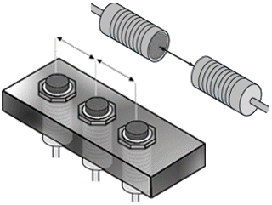
Mutual Interference
If proximity sensors are mounted close together they can interfere with each other's operation. This effect is called "Mutual interference". This can occur if they are placed face to face or side by side.
In the next pages you can find detailed instructions about the installation of more proximity sensors.
Mutual Interference

Slide 16
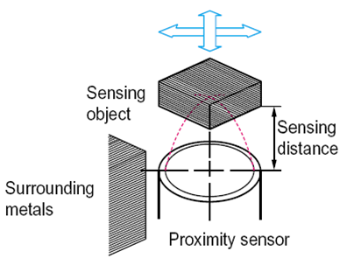
Inductive Sensor Selection
To conclude: When selecting the right proximity sensor for an application several things have to be taken into consideration:
Specific conditions of object (metal type, size, plating)
Direction of target movement
Speed of target
Effects of surrounding metal
Effects of temperature, voltage, EMC, vibration, shock, humidity, oil, powder, chemicals or detergent
Required sensing distance
Detection process

Slide 17
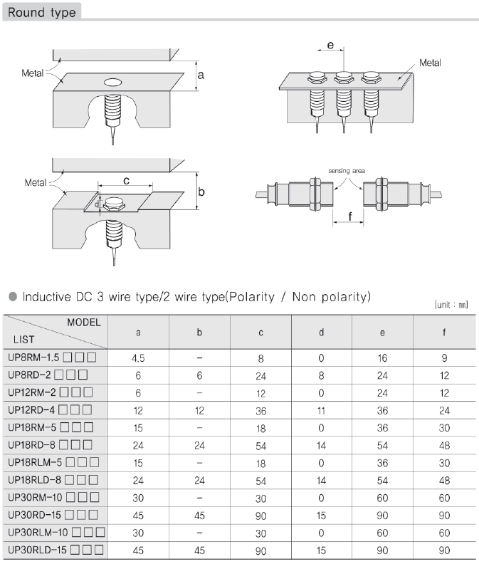
Installing more proximity sensors (round type)
Installing more than one proximity sensor in parallel or facing each other, can cause malfunction, for example abnormal return due to he interference of surrounding metal.
In order to avoid the potential malfunction caused by surrounding metals, please install the proximity sensors with sufficient gap among each other. The gap should be higher than the values shown in the left chart.
On the left chart you may find the values for Inductive DC 3 wire type/ 2wire type. The values for other models are shown in the next pages.

Slide 18
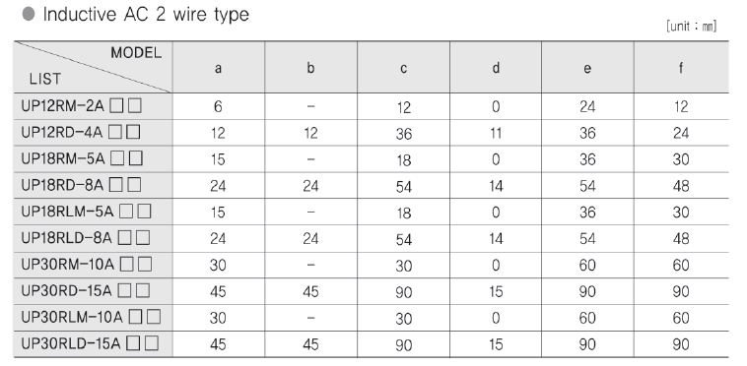
On the left you can find the values for Inductive AC 2 wire type proximity sensor.

Slide 19
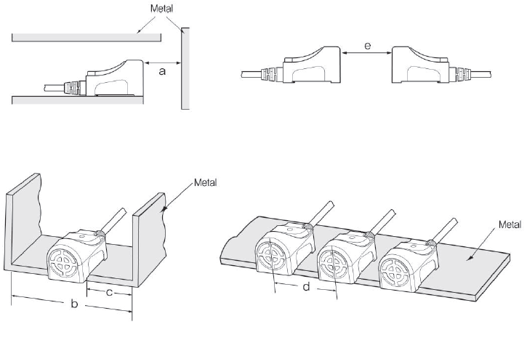
Installing more proximity sensors (square type)
On the left you may find pictures showing the installation of square type proximity sensors, and on the next pages you will find the minimum gap values.

Slide 20
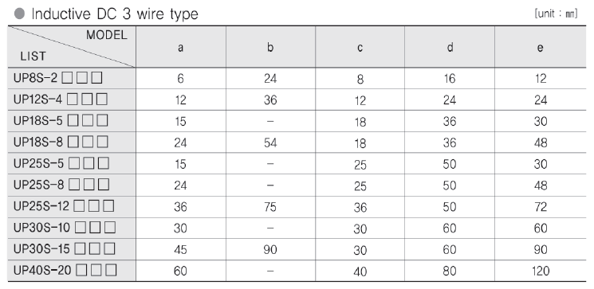
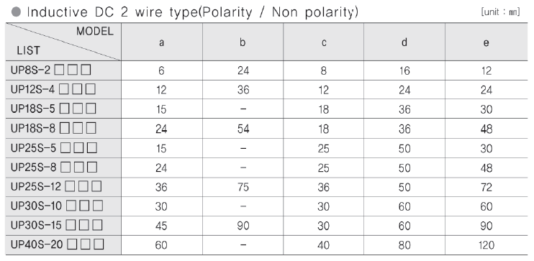
On the left chart you may find the minimum gap values for Inductive DC 3 wire and 2 wire types.

Slide 21
On the left chart you may find the minimum gap values for Inductive AC 2 wire types.

Slide 22
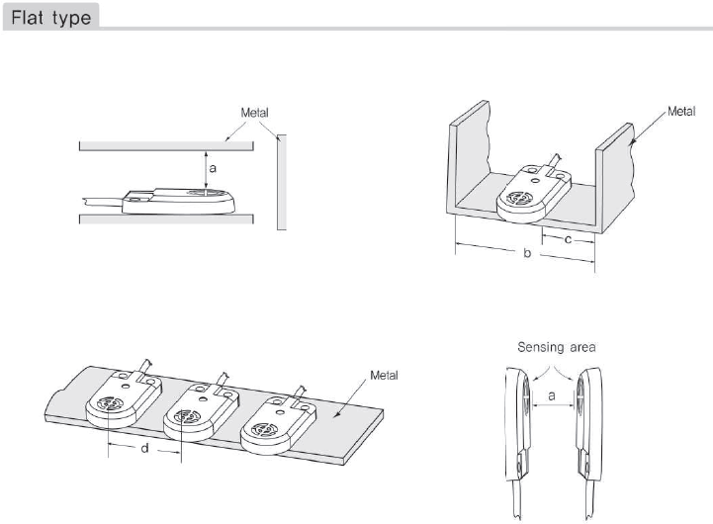
Installing more proximity sensors
(flat type)
On the left you may find pictures showing the installation of flat type proximity sensors, and the minimum gap values.

Slide 23
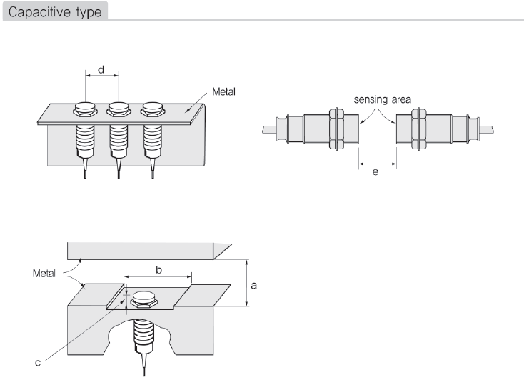
Installing more proximity sensors (capacitive type)
On the left you may find pictures showing the installation of flat type proximity sensors, and the minimum gap values.

Slide 24
Proximity sensor terminology
Term | Description
UP | Upgraded Proximity sensor (Inductive type)
CUP | Capacitive Upgrade Proximity sensor
Magnetic Field | The space around the magnetic pole (magnetic pole) or around the conductor through which current flows
Electric Field | The electric field strength around the conductor when the current flows in the conductor
Sensing Distance | Distance from the first operating position to the detection surface when the standard sensing object is brought close to the front side
Standard sensing object | A detection object used to decide the basic characteristics (shape, size, material)
Earth Capacity | The capacitance between the ground and the object
Shield Type | The internal detection coil is covered with metal. Relatively short detection distance, but strong against ambient noise
Non-Shield Type | The detection coil is not covered with metal. It can easily be affected by surrounding metal, but has longer sensing distance
Normal Open (N.O.) | Normal Open, output when the detected object approaches the set distance range
Normal Closed (N.C) | Normal Close, output when the detected object is out of the set distance range

Slide 25
IP code structure (IEC 60529)
Hanyoung Nux proximity sensors IP code: IP67. You may find detailed information about the IP code below and in the next pages.
First digit: Solid particle protection
Level | Effective against | Description
0 | — | No protection against contact and ingress of objects
1 | >50 mm | Any large surface of the body, such as the back of a hand, but no protection against deliberate contact with a body part
2 | >12.5 mm | Fingers or similar objects
3 | >2.5 mm | Tools, thick wires, etc.
4 | >1 mm | Most wires, slender screws, large ants etc.
5 | Dust protected | Ingress of dust is not entirely prevented, but it must not enter in sufficient quantity to interfere with the satisfactory operation of the equipment.
6 | Dust tight | No ingress of dust; complete protection against contact (dust tight). A vacuum must be applied. Test duration of up to 8 hours based on air flow.
** For the second digit (Liquid ingress protection), look at the next page **

Slide 26
Second digit: Liquid ingress protection (1~5)
Level | Effective against | Description
0 | None | —
1 | Dripping water | Dripping water (vertically falling drops) shall have no harmful effect on the specimen when mounted in an upright position onto a turntable and rotated at 1 RPM.
2 | Dripping water when tilted at 15° | Vertically dripping water shall have no harmful effect when the enclosure is tilted at an angle of 15° from its normal position. A total of four positions are tested within two axes. Water falling as a spray at any angle up to 60° from the vertical shall have no harmful effect, utilizing either: a) an oscillating fixture, or b) A spray nozzle with a counterbalanced shield. Test a) is conducted for 5 minutes, then repeated with the specimen tilted 90° for the second 5-minute test. Test b) is conducted (with shield in place) for 5 minutes minimum.
3 | Spraying water | Water falling as a spray at any angle up to 60° from the vertical shall have no harmful effect, utilizing either: a) an oscillating fixture, or b) A spray nozzle with a counterbalanced shield. Test a) is conducted for 5 minutes, then repeated with the specimen tilted 90° for the second 5-minute test. Test b) is conducted (with shield in place) for 5 minutes minimum.
4 | Splashing of water | Water splashing against the enclosure from any direction shall have no harmful effect, utilizing either: a) an oscillating fixture, or b) A spray nozzle with no shield. Test a) is conducted for 10 minutes. Test b) is conducted (without shield) for 5 minutes minimum.
5 | Water jets | Water projected by a nozzle (6.3 mm) against enclosure from any direction shall have no harmful effects.
** The liquid ingress protection levels continue in the next page **

Slide 27
Second digit: Liquid ingress protection (6~9K)
Level | Effective against | Description
6 | Powerful water jets | Water projected in powerful jets (12.5 mm nozzle) against the enclosure from any direction shall have no harmful effects.
6K | Powerful water jets with increased pressure | Water projected in powerful jets (6.3 mm nozzle) against the enclosure from any direction, under elevated pressure, shall have no harmful effects. Found in DIN 40050, and not IEC 60529.
7 | Immersion, up to 1 m depth | Ingress of water in harmful quantity shall not be possible when the enclosure is immersed in water under defined conditions of pressure and time (up to 1 m of submersion).
8 | Immersion, 1 m or more depth | The equipment is suitable for continuous immersion in water under conditions which shall be specified by the manufacturer. However, with certain types of equipment, it can mean that water can enter but only in such a manner that it produces no harmful effects. The test depth and/or duration is expected to be greater than the requirements for IPx7, and other environmental effects may be added, such as temperature cycling before immersion.
9K | Powerful high temperature water jets | Protected against close-range high pressure, high temperature spray downs. Smaller specimens rotate slowly on a turntable, from 4 specific angles. Larger specimens are mounted upright, no turntable required, and are tested freehand for at least 3 minutes at distance of 0.15–0.2 m. There are specific requirements for the nozzle used for the testing.

Slide 28
Proximity sensor types
Grouping by detection method
- Sensors using magnetic fields
1) High frequency oscillation type
2) Differential coil type
3) Magnetic type
- Sensors using electric fields
1) Capacitive type
Grouping by detection head
- Shield type
- Non shield type
Grouping by output circuit
- High frequency oscillation type
1) DC 2 wire type
2) DC 3 wire type
3) NPN, PNP
4) AC 2 wire type
- Capacitive type:
1) DC 3 wire type
2) NPN, PNP
3) 2 wire type AC/DC dual usage

Slide 29
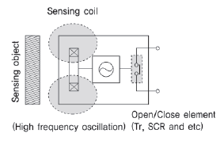
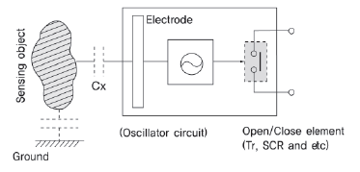
Proximity sensor principles
High frequency oscillation type
Recognizes metallic materials by using magnetic field
A high frequency magnetic field is generated in the oscillation coil inside the detection surface. When the detecting object approaches the magnetic field, the output signal is activated by detecting the heat loss caused by the induction current
Capacitive type
Recognizes metallic and non-metallic objects by using electric field
The detection unit has an induction electrode. When an object approaches the electrode, the electrostatic capacity between the induction electrode and the ground changes, and the amount of change is detected to operate the output signal

Slide 30
Proximity sensor features
Non-contact detection system
- Unlike mechanical sensors, non-contact detections prevent damages to the detection object and sensor.
Positioning with high precision repeatability
- Composed by semiconductor circuit for excellent precision.
High response speed
- High response speed by comparing magnetic field or electric field signal strength
Semi-permanent usage
- It consists of IC, TR, etc. and can be used semi-permanently.
Excellent environmental resistance
- Molding structure made of copper pipe and plastic structure, resistant to acid

Slide 31
Detecting objects and distance
Sensing distance ratio according to detecting object type

Slide 32
Proximity sensor 3-wire / 2-wire comparison
3 wires
Advantages | Disadvantages
No influence of leakage current and voltage drop. | The wiring is more expensive than 2 wires. DC power is needed
Directly fit for PLC, INVERTER | Need to decide between PNP and NPN
2 wires
Advantages | Disadvantages
Simple wiring | Leakage current and voltage drop occur
Wiring cost less than 3-wire type | Minimum load must be applied

Slide 33
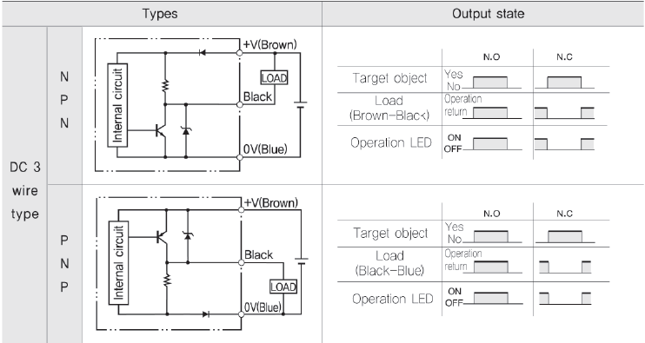
Sensor output circuit
3 wire NPN / PNP output circuit, operation

Slide 34
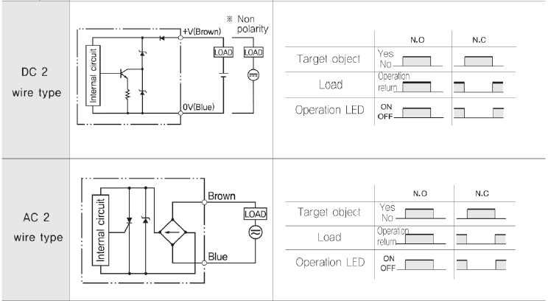
Sensor output circuit
2 wire output circuit, operation

Slide 35
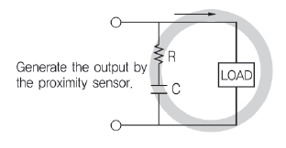
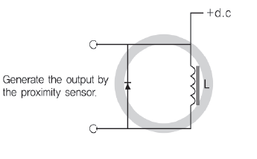
Wiring
Surge absorber connection in parallel with load
Caution!
During the wiring, please do not use the same conduit for power line and high tension line. Failure to do so will cause malfunction.
When the cable extension is less than 100m, use a cable above 0.3 square mm. When the cable extension is more than 100m, please use a cable with conductor resistance less than 100Ω/km. Please note that extending the cable in high response may result in output wave form distortion
Connect inductive loads (relays, motors, magnets, etc.)

Slide 36
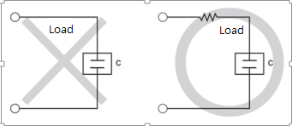
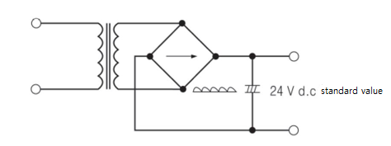
Load connection method
Condenser load connection
Power used for direct current sensors
- Full wave rectification power source used
- The ripple content is no more than 10%

Slide 37
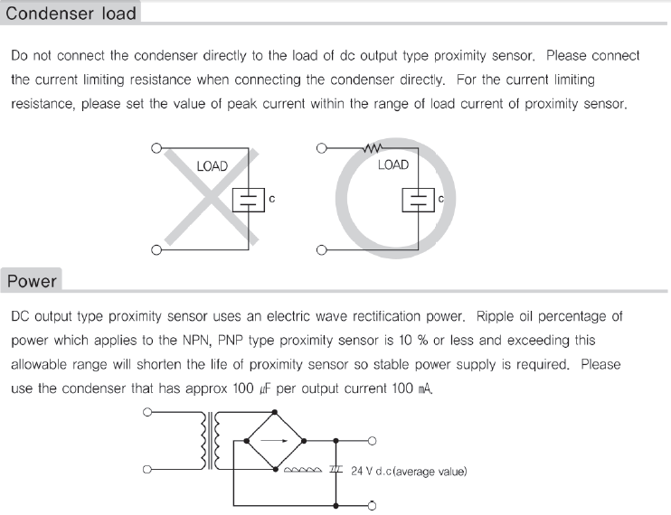
Useful information

Slide 38
Useful information

Slide 39
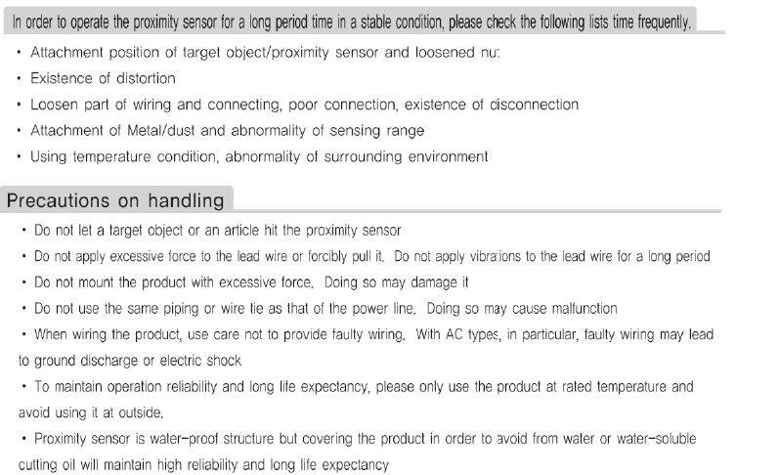

Slide 40
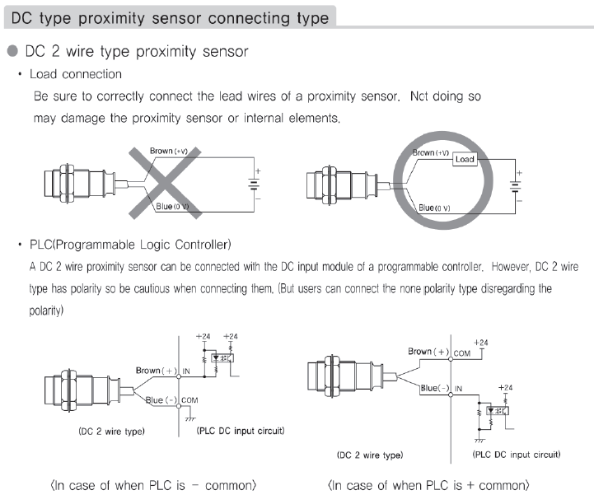
Useful information

Slide 41
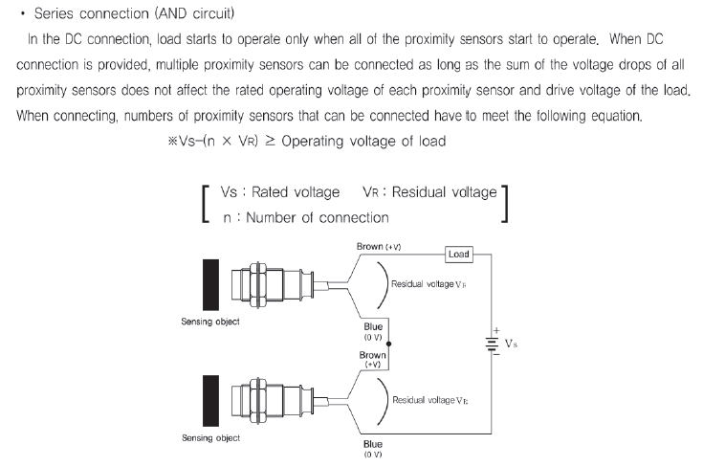
Useful information

Slide 42
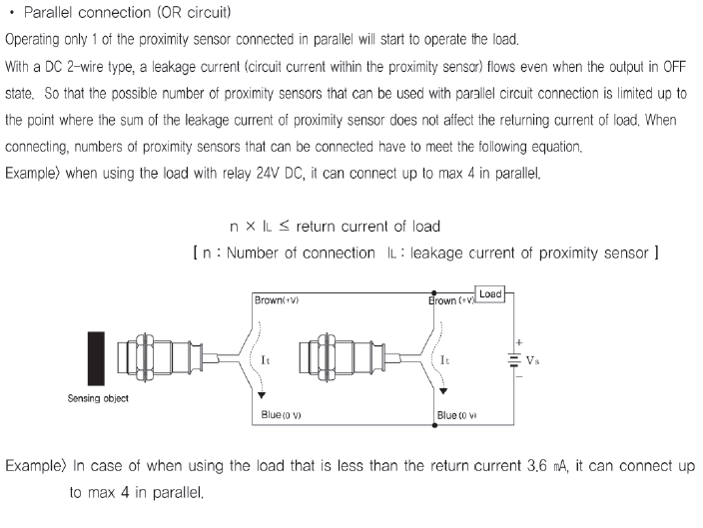
Useful information

Slide 43
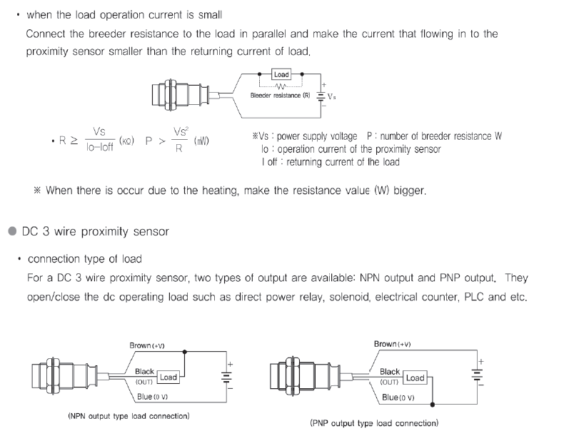
Useful information

Slide 44
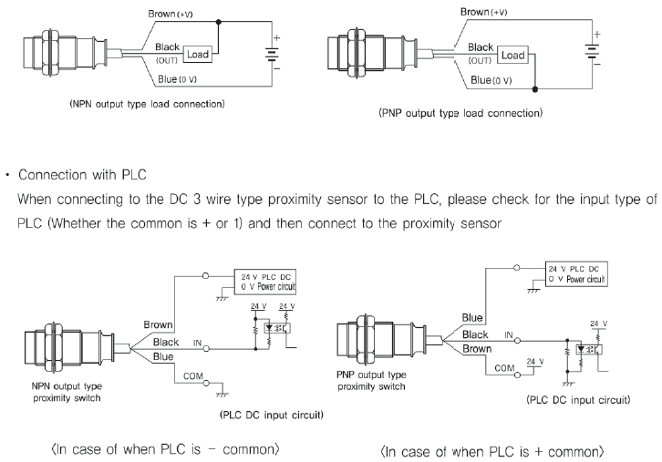
Useful information

Slide 45
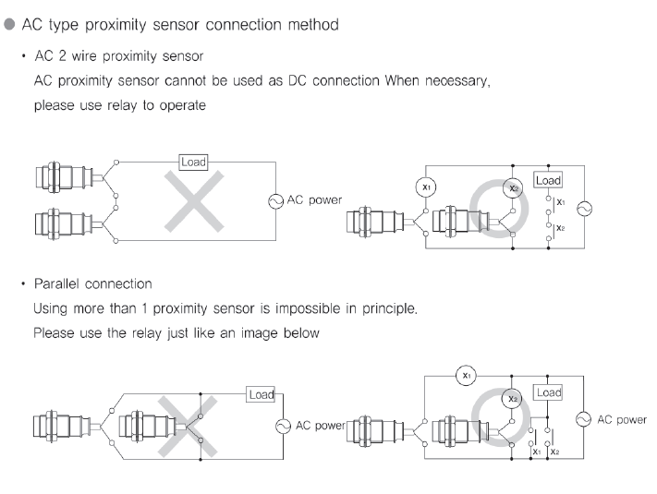
Useful information

Slide 46
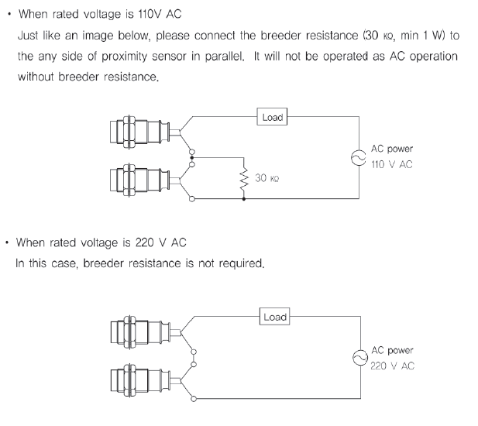
Useful information

Slide 47
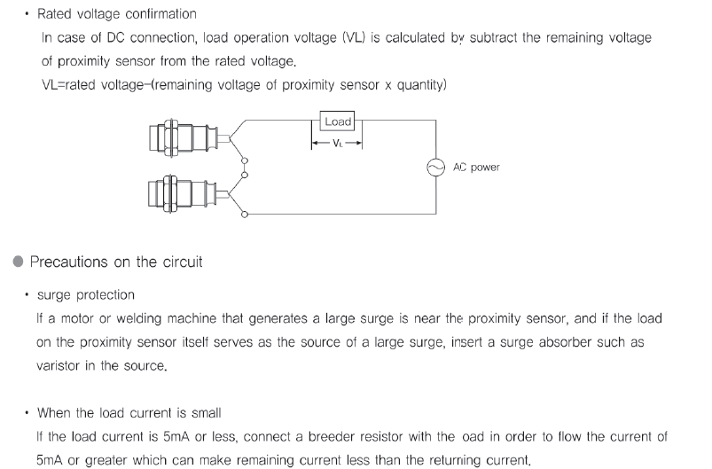
Useful information

Slide 48
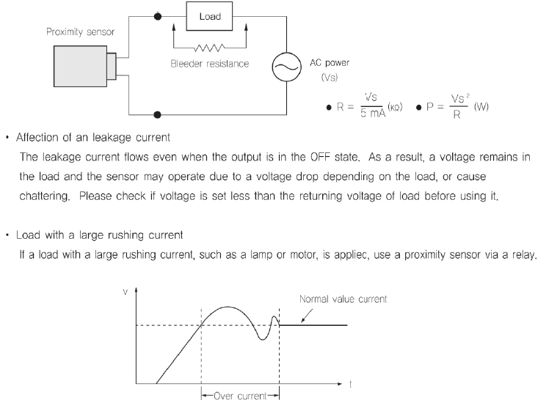
Useful information

Slide 49
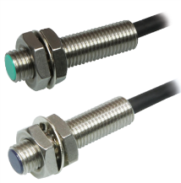
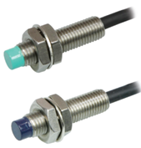
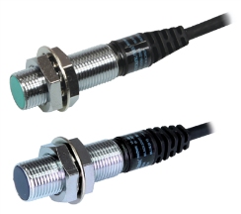
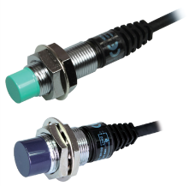
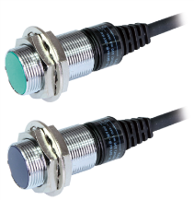
Proximity sensor suffix code (UP round type)
UP 18 R M - 5 N A C
Shield Type
Non-shield type
Inductive
Round
Division | Code | Content
Connection | - | Cable type (no indication)
 | C | Connector type
 | CR | Relay connector type
Output type | A | NO (Normal Open)
 | C | NC (Normal Closed)
Power and output type | N | NPN Type (DC 3 wire)
 | P | PNP Type (DC 3 wire)
 | A | AC 2 wire
 | T | DC 2 wire (Polarity)
 | U | DC 2 wire (No Polarity)
Sensing distance |  | 1.5, 2, 4, 5, 7, 8, 10, 14, 15, 25
Shield/Non shield | M | Shield type
 | D | Non shield type
Sensing area size |  | 8, 12, 18, 30
UP8RM-1.5N/P* | UP8RD-2N/P*
UP12RM-2N/P* | UP12RD-4N/P*
UP18RM-5N/P* | UP18RM-8N/P*
UP30RM-10N/P* | UP30RM-15N/P*

Slide 50
Proximity sensor suffix code (UP square type)
UP 18 S - 5 N A C U
Division | Code | Content
Sensing direction | - | No indication (Detect front side)
 | U | Deect upper side (only available with UP18S)
Connection structure | - | No indication (Cable type)
 | CR | Relay connector
Output state | A | NO (Normal Open)
 | C | NC (Normal Closed)
Power and output type | N | DC NPN Type 3 wires
 | P | DC PNP Type 3 wires
 | A | AC 2 wires (UP18S excluded)
 | T | DC 2 wires (polarity)
 | U | DC 2 wires (non polarity)
Sensing distance |  | 2, 4, 5, 8, 10, 12, 15, 20
Sensing area size |  | 8, 12, 18, 25, 30, 40
UP12S-4N/P*
UP18S-5N/P*
UP25S-8N/P*
UP30S-10N/P*
UP40S-20N/P*
Inductive
Flat

Slide 51
Proximity sensor suffix code (UP flat type)
UP 25 F - 8 N A CR
Division | Code | Content
Connection structure | - | No indication (Cable type)
 | CR | Relay connector
Output state | A | NO (Normal Open)
 | C | NC (Normal Closed)
Power and output type | N | NPN Type (DC 3 wire)
 | P | PNP Type (DC 3 wire)
 | A | AC 2 wire
 | T | DC 2 wire (Polarity)
 | U | DC 2 wire (No Polarity)
Sensing distance |  | 8
Sensing area size |  | 25
Inductive
Flat
UP25F-8N/P*

Slide 52
Proximity sensor suffix code (CUP round type)
CUP 18 R - 8 N A CR
Division | Code | Content
Connection structure | - | No indication (Cable type)
 | CR | Relay connector
Output state | A | NO (Normal Open)
 | C | NC (Normal Closed)
Power and output type | N | NPN Type (DC 3 wire)
 | P | PNP Type (DC 3 wire)
 | F | AC/DC 2 wire type dual usage. No polarity
Sensing distance |  | 8, 15
Structure type | R | Brass chrome plating case
 | RP | Plastic case
Sensing area size |  | 18, 30
Plastic case
Brass chrome plating case
Capacitive
CUP18R-8N/P*
CUP30R-15N/P*

Slide 53
Proximity sensor cables
Connector cables

Slide 54
Proximity sensor cables
Relay cables

Slide 55
Thank you!

